Slide 1

IOT PROJECT
NOISE POLLUTION MONITORING
PHASE-2

Slide 2

OBJECTIVE/GOAL :
The primary objective of the Noise Pollution Detector IoT project is to design and implement a sophisticated monitoring system capable of real-time noise level analysis. This system aims to contribute to urban environmental quality assessment by providing accurate, reliable, and continuous noise pollution data. The collected data will empower policymakers, urban planners, and environmental agencies to make informed decisions for noise abatement and urban planning initiatives.

Slide 3

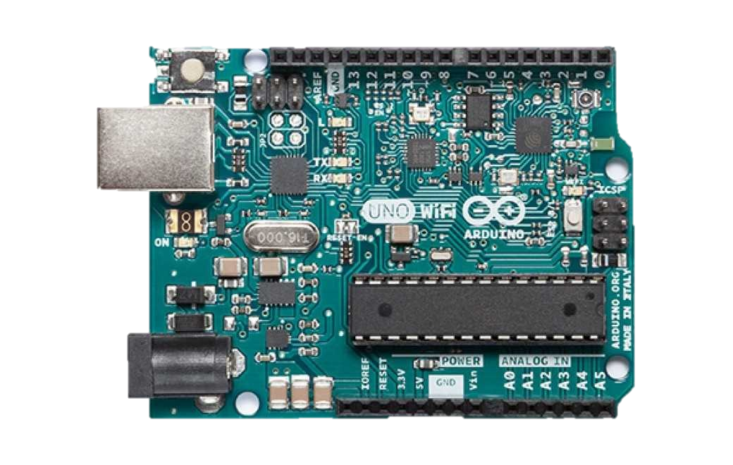
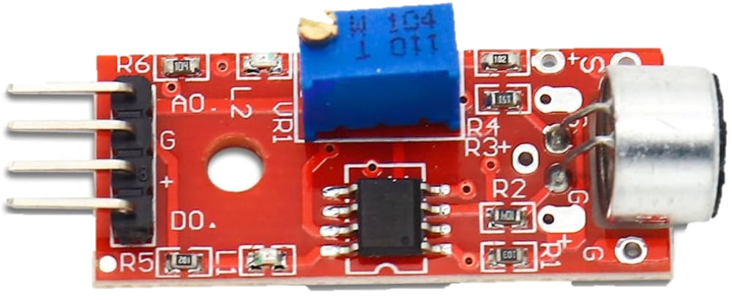
MATERIALS TAKEN :
We have taken ESP32 microcontroller and as well as Arduino board ,as I think its suitable for this project.
Rest of the materials are mentioned below :
KY-037 Sound Sensor.
WiFi (Connectivity).
Website (As a display).
LED.
IOT-AWS (Data collection).
Connecting wires.
We are using C programming language and the below tools:
1) IOT CLOUD.
2) TINKER CAD(for experiments) .

Slide 4

MODULES :
MODULE 1 : Hardware Assembly Module
The Hardware Assembly Module is responsible for handling the hardware components, sensor interface, user interaction, and hardware control within the project.
Step 1 :Set Up Arduino board
Connect your Arduino board to a monitor, keyboard, and mouse.
Insert the microSD card with Arduino board OS.
Power up the Arduino board using an appropriate power supply.
Step 2 : Install Required Software
Boot up the Arduino board log in, and ensure it's connected to the internet.
Open a terminal and update the system packages.
install the necessary python packages(RPi.GPIO,FLASk,PyDub, Matplotlib)using pip.
Set up any additional software required for your IoT communication.

Slide 5

MODULE 2 : Data collection Module
Step 1: Set Up AWS IoT Core
Create an AWS IoT Thing:
Log in to your AWS account and navigate to AWS IoT Core.
Create an IoT Thing representing your Arduino board or noise sensor device.
Generate and download X.509 certificates for your device (certificate and private key), or use AWS IoT's default certificate for quick testing.
Create an AWS IoT Topic:
Create an IoT Topic in AWS IoT Core to publish and subscribe to noise level data.
Define a topic name (e.g., "noise_data").
Step 2: Implement Data Collection on Arduino board
Install AWS SDK and Configure Credentials:
Install the AWS SDK for Python (Boto3) on your Raspberry Pi if not already installed.
Configure AWS credentials on the Arduino board
Enter your AWS Access Key ID, Secret Access Key, region (e.g., us-east-1), and output format.(NOTE: Data distribution and Credentials are managed and code will be submitted in later phase)

Slide 6

MODULE 3 : User Interface Module
Step 1: Setup the Web Page
Create a basic HTML web page with placeholders for displaying noise levels for different locations. You can use a text editor to create an HTML file.
Add HTML elements to structure the page, such as headers, paragraphs, and tables.
Create a section where you will dynamically display the noise levels for each location.
Step 2 : Display Real-Time Noise Data
Use JavaScript to fetch real-time noise data for various locations from a data source. You can set up a simple JSON file or use a web server.
Update the placeholders in your HTML page with the fetched noise data. You can use JavaScript to manipulate the DOM and display the data in a tabular format.
Implement automatic data refreshing at regular intervals to keep the noise levels up to date.
Step 3 : Deploy the Website
Host your HTML, JavaScript, and CSS files on a web server. You can use a hosting service or set up your own server.
Ensure that the website is accessible via a web browser by sharing the server's URL or IP address.
Provide clear instructions for users on how to navigate the website, select locations, and view noise levels.

Slide 7

FINAL MODULE : Assembly Module
Step 1 : Hardware Setup and Initialization
Set up the Arduino board and connect the microphone sensor, buttons, and LEDs to the GPIO pins.
Initialize the GPIO pins to control hardware components.
Create functions to read data from the microphone sensor and control the LEDs based on sensor readings.
Monitor user interactions with buttons to trigger actions (e.g., start/stop data collection).
Step 2 : Data Collection and Integration
Continuously collect real-time noise level data from the microphone sensor.
Process the collected data if needed (e.g., filtering).
Make the real-time noise data accessible through an API on the Arduino board
Step 3 : User Interface Integration and Deployment
Develop a simple web-based user interface using Flask with routes for displaying real-time noise data.
Use JavaScript to request real-time noise data from the Arduino board API.
Display the real-time noise data on the web interface, and ensure user interactions (e.g., starting/stopping data collection) trigger actions via API calls.
Host the integrated system on the Arduino board and make it accessible via a web browser.

Slide 8

THANK YOU

